Slide 1
Essential Guide for teams
Mastering WonTask
All rights reserved © WonTask

Slide 2
Which problems does WonTask solve?
Scattered communication from messages, emails, live chats... is in one place, it's easy to track who did and submitted what and when.
Errors due to forgetting the details of the assigned task are eliminated
Forgetting a specific task due to other work is eliminated
A single repository for all completed tasks with easy search

Slide 3
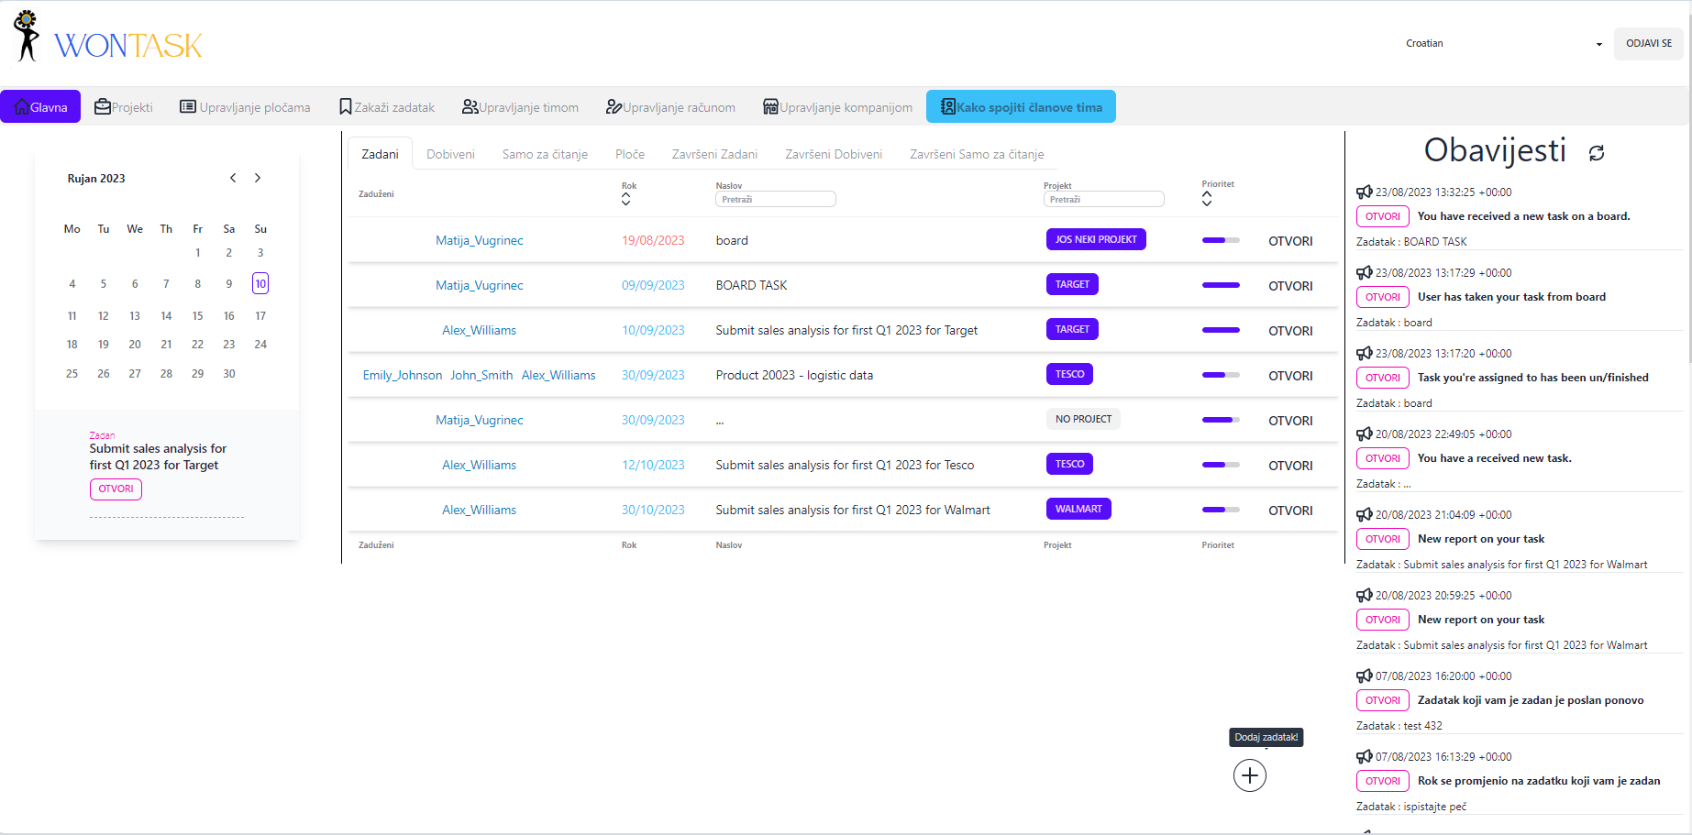
Easy sorting and searching
Choose Given or Received tasks
After an event relevant to you occurs, you receive a notification.
For each date, see which tasks must be completed
Task display

Slide 4
Left-clicking on this place allows expanding the task description for longer tasks
Fill in the basic information about the task
Select the people responsible for the task. Hold CTRL and select multiple.
If necessary, add a file (up to 10MB).
Multiple files require ZIP
Select the desired completion date and priority
Double-clicking this location deletes the selected file
You can assign a task to 1 or more projects that you can then search by later
You can also add read-only users to a task. These are users who cannot submit reports for the task nor are they in charge of it, but can only read what others submit
You can also assign conditions to the task in the form of other tasks. Those other tasks must be completed before the current task can be started.

Slide 5
You can also add the task to the board.
Boards group several users who, after receiving a task on the board, can choose who will take it over.

Slide 6
Create a new board with a title and description
Edit which boards are active and which are inactive
Edit board members

Slide 7
Edit who is currently active on a particular board

Slide 8
On the board section, we see all the tasks from the boards to which we are connected.
We can take over the task there.

Slide 9
Adding and editing project activities is the same as with a board.
It is possible to add other team members to the project so they can use it too.

Slide 10
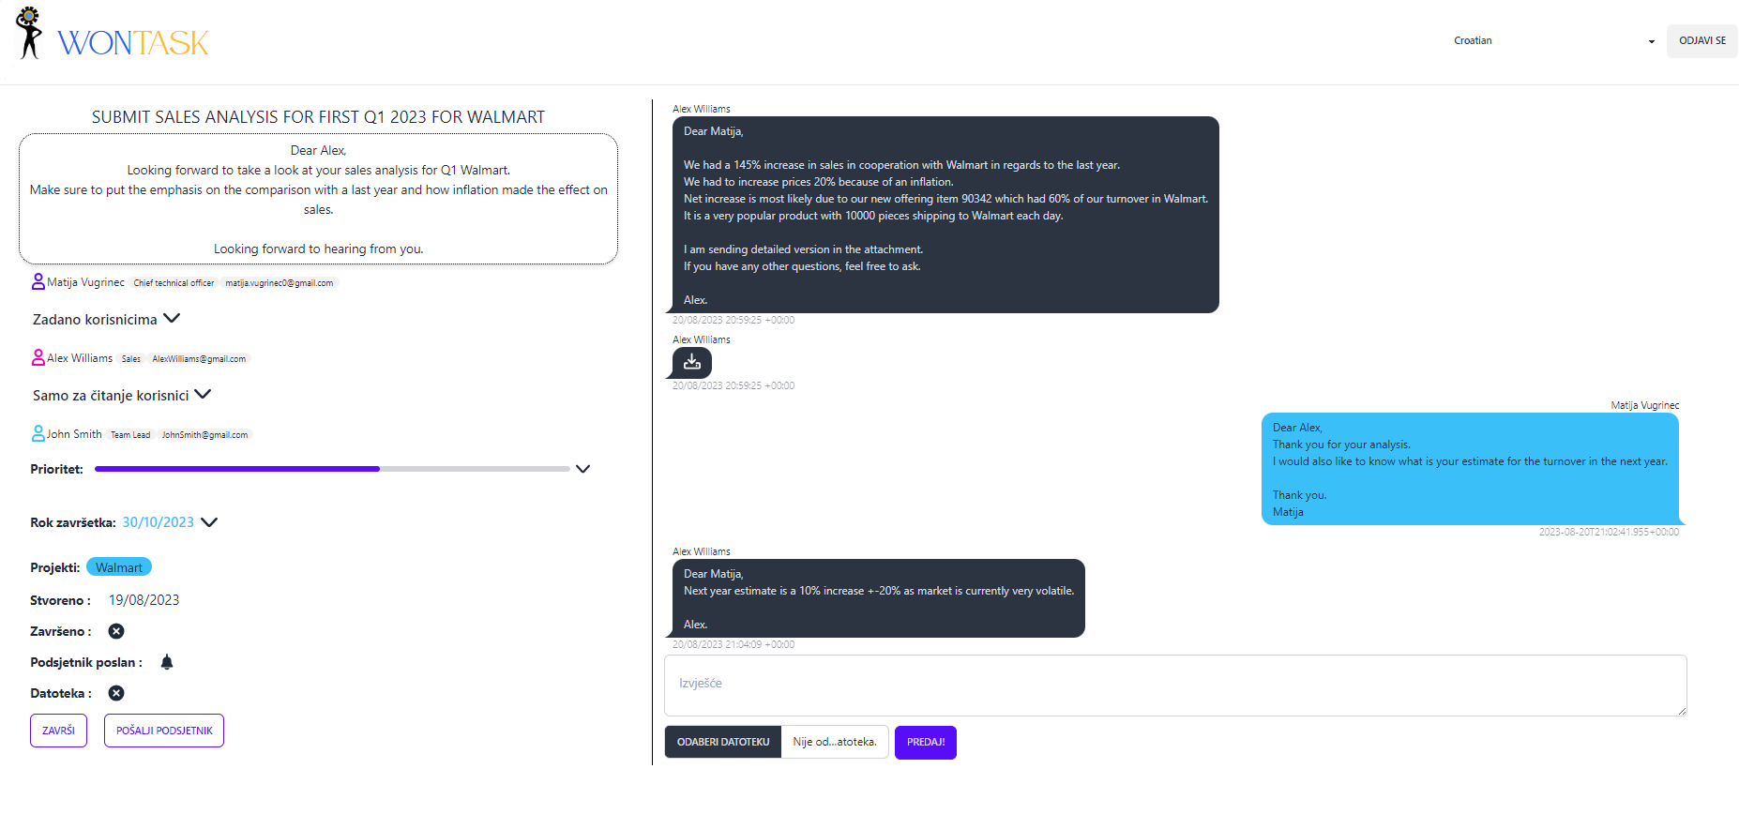
Simple communication + adding files as needed.
The one who assigned the task can simply finish it, send a reminder or restart it.

Slide 11
The assignor can easily change who is responsible for the task, who the read-only users are, when the completion date is, and what the priority is.

Slide 12
app.wontask.com
Registration -> connect to an existing company

Slide 13
When creating an account, enter the company ID that your moderator must give you.

Slide 14
Fill in the basic information and create an account. After you confirm your email and after the moderator activates you, you will be able to use WonTask

Slide 15
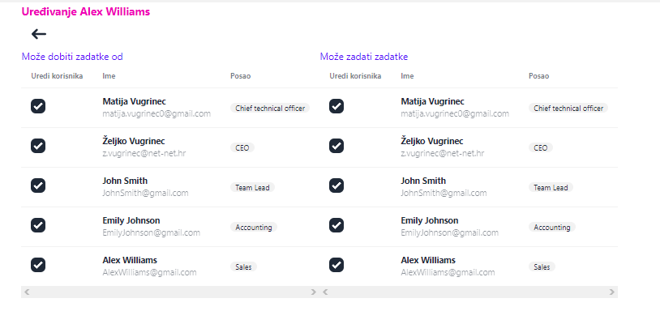
For moderators
The moderator can arrange who can assign tasks to whom.

Slide 16
In order for a team member to be able to use WonTask, it must be activated by a moderator

